Slide 1
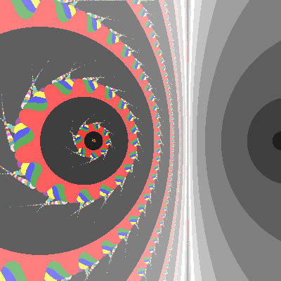
Final Presentation
Constantine Stoumbos
with mentor
Dr. Bahman Kalantari

Slide 2
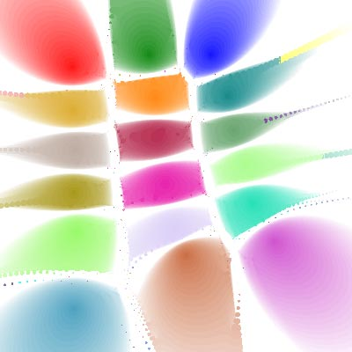
Quick Review: What is polynomiography?
Dr. Kalantari informally defines polynomiography as a certain graph of polynomials
He formally defines it as the art and science of visualization in approximation of the zeros of complex polynomials, via fractal and non-fractal images created using the mathematical convergence properties of iteration functions

Slide 3
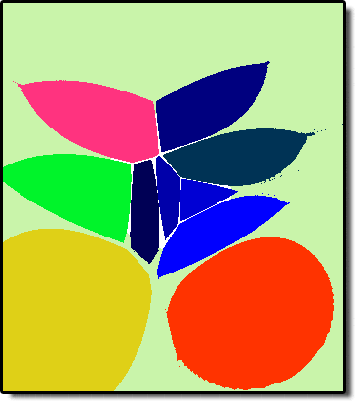
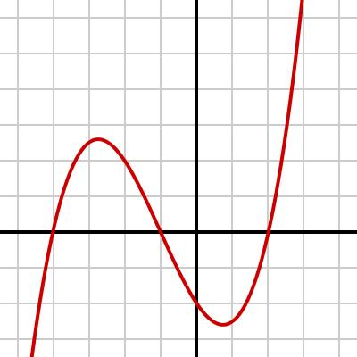
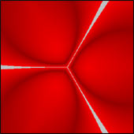
Iteration functions are used to determine which points will eventually map to the roots of the function being analyzed, essentially the objective of polynomiography
Newton’s Method is an example:
N(z) = z − p(z)/p’(z)
By producing a graph of these regions of convergence, or polynomiograph, we can represent functions is a new way:
              VS

Slide 4
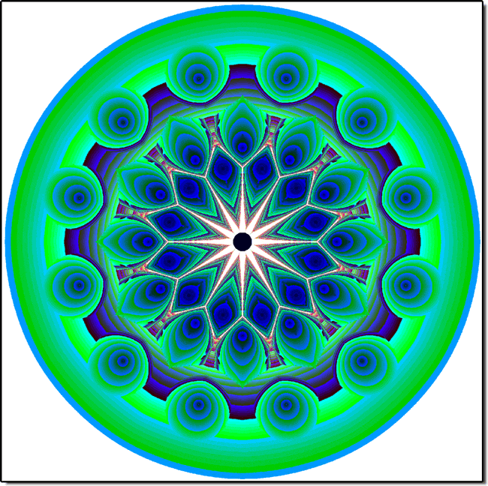
What’s New?
In my study of polynomiography, I have developed a program which allows one to easily play around with Voronoi diagrams (the “skeletons” of polynomiographs) and convex hulls
This allows one to develop a better understanding of the advantages of polynomiography
http://dimax.rutgers.edu/~costas/
Notes:
-educational tool for acquainting with polynomiography, complex polynomials, and root behavior
-can be used by mathematicians to analyze root development from degree to increasing degree and uncover principles that govern it

Slide 5

Additional Project
I’m also working on an optimization problem that involves the placement of a security camera in an art exhibit
But what does this have to do with polynomiography and complex polynomials?
It turns out that answering our question is equivalent to maximizing the modulus of a polynomial whose roots are the three vertices

Slide 6

Thanks for Listening!
All images from www.polynomiography.com, Dr. Kalantari’s website

